Slide 1
A Basic Web Script
My example is at http://www.csit.parkland.edu/~kurban/csc125/webprogramI/
Web output from C++

Slide 2
Overview
Where a file is placed matters! Specifically for this class, everything needs to be under ~/public_html/cgi-bin
each project should be in a different folder, for instance you’ll have folders like ~/public_html/cgi-bin/lab1 and ~/public_html/cgi-bin/lab2
to create a folder under the current folder, the linux command is:
mkdir foldername
To show (print) the current working directory (folder) the command is:
pwd

Slide 3
More linux
To change the current working directory the command is:
cd
cd foldername
cd ..
to show (list) the files in the current folder, the linux command is:
ls
ls -l
to edit a file in the current folder, the linux command is:
pico filename
to compile in a folder the linux command is:
g++ *cpp -o executablename
home directory
down to foldername
up to parent directory
use other editors if you wish
lab1.cgi for this lab

Slide 4
Connections
The directory
~/public_html/cgi-bin/Lab1
is connected to the URL
http://www.csit.parkland.edu/~username/cgi-bin/Lab1
For instance, the code I wrote for this lesson is at
http://www.csit.parkland.edu/~kurban/csc125/webprogramI/
is in the directory
~kurban/public_html/csc125/webprogramI

Slide 5
Copying files
~kurban means my home directory
You can copy my files with the command:
cp ~kurban/public_html/csc125/webprogramI/* .
the * means all the files
the dot means the current directory
Where my files are
Since these files are on the web, you can also access them via the url:
http://www.csit.parkland.edu/~kurban/csc125/webprogramI

Slide 6
Apache-CGI programming
Someone on the internet will start our program through a link and the program should OUTPUT the http response that’s sent back to that person's browser. The browser will take the html from the http response and render it on the screen.
The executable need to be under the public_html/cgi-bin directory
The executable needs to have a .cgi extension
g++ *cpp -o lab1.cgi
The executable needs to complete the http header with
cout << "Content-type: text/html" << endl << endl;

Slide 7
To Do List
log on to www.csit.parkland.edu
cd public_html/cgi-bin mkdir lab1 cd lab1 pico lab1.cpp
Edit your program
g++ lab1.cpp -o lab1.cgi
Open http://www.csit.parkland.edu/~username/cgi-bin/lab1 in a browser, click on lab1.cgi
Debug by returning to the editing command.
only need this command once

Slide 8
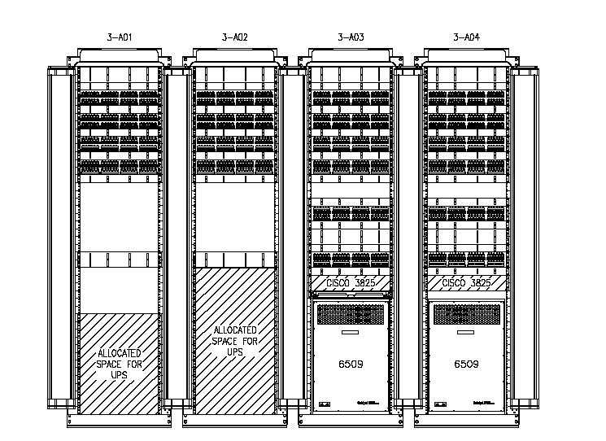

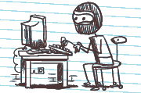
The Web
other servers
XML (RSS)
server
user-agent
(browser)
http request
dynamic server side program (executable)
internet
SQL
database
http response

Slide 9


How it works
You use putty.exe (windows) or ssh (apple) to connect to the remote server
source code
Someone running your program from somewhere on the web. (It might be you or me!)
your computer
You edit and compile source code.
internet
Someone runs the executable
www.csit.parkland.edu

Slide 10
what is http
http://www.tutorialspoint.com/http/http_messages.htm
https://en.wikibooks.org/wiki/Communication_Networks/HTTP_Protocol
Your code needs to output http for the browser to work with. Since http is text based, it's not hard.

Slide 11
Your program needs to be an http response. Below is what one looks like. You need to output (to cout) the parts 'provided by our program'.
200 OK
Content-type: text/html
Hello world
Provided by apache
blank line
Provided by your program
html content you provide

Slide 12
The minimal code for the lab
int main() { cout << "Content-type: text/html\n\n"; cout << "Hello Web"; }

Slide 13
When an internal server error occurs:
run the program from the command line, this will check for permissions.
if it runs, check the http header carefully, make sure there is a blank line after 'Content-type'
ask Ken (giving him your username will help)

